Slide 1
Distributed Middleware Frameworks
DCE and CORBA

Slide 2
Distributed Computing Environment (DCE)
Architecture proposed by OSF
    Goal: to standardize an open UNIX envt to support distributed computing
First product from OSF
    Integrated package of software and tools for developing distributed applications on an existing OS (UNIX or non-UNIX)
Hierarchically layered architecture

Slide 3
DCE Overview
Why DCE ?
Provides tools( DCE threads,RPC) and services( Directory service et.all) to support distributed applications
DCE components are well integrated
  Placement of each service in the hierarchically layered architecture is important.
Provides interoperability and portability across heterogeneous platforms
Supports data sharing
Interoperates with global computing environments

Slide 4
DCE Hierarchy
  Kernel and Transport Service
  Processes and Threads
      Basic computational units supported by the kernel. Everything else is a user-level component that communicate via RPC and group comm.
  RPC and group communication
  Basic system services
      Time, naming
  Distributed File Service
  Distributed Services
      Concurrency control, group management
  Applications

Slide 5
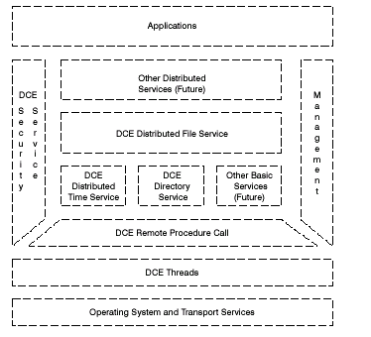
DCE Overview
DCE architecture overview

Slide 6

DCE Overview
DCE supports
The client server model
Remote Procedure call model
Data sharing model (Directory service, DFS)
Distributed Object Model

Slide 7
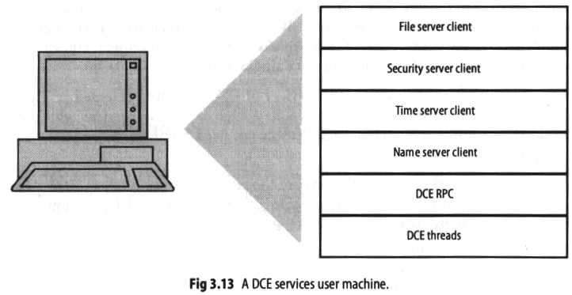

Slide 8
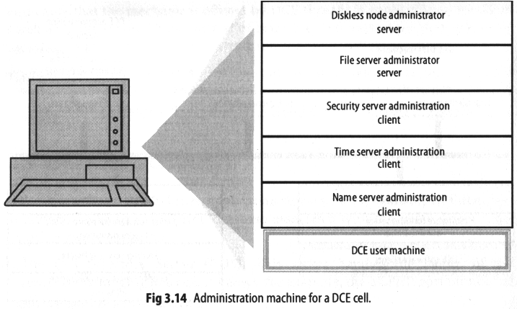

Slide 9
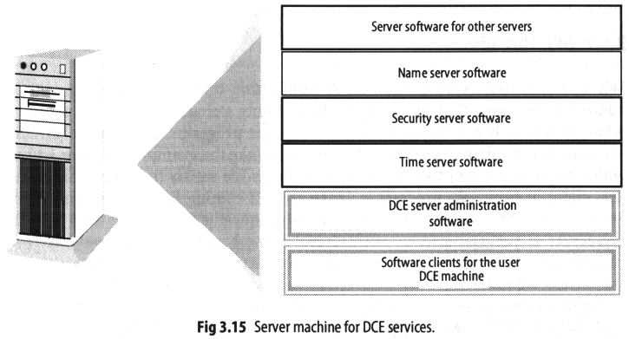

Slide 10
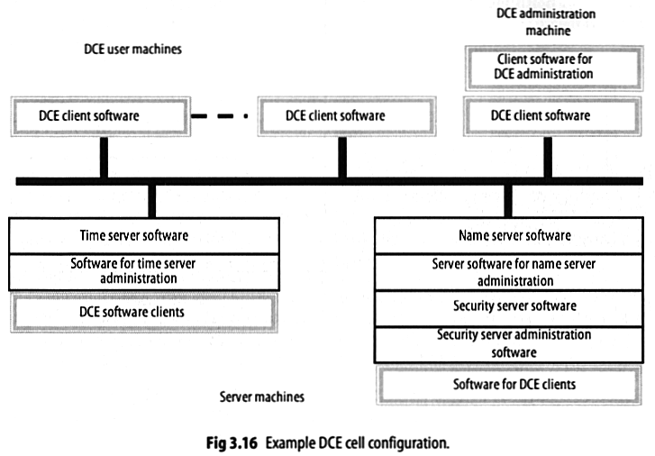

Slide 11
DCE Technology Components:
DCE Threads
DCE Programming facilities
DCE Threads
  Provided as a user space library based on pthreads
interface specified by POSIX
  Thread scheduling done on basis of scheduling priorities and policies ( such as RR, FIFO)
  Communication and synchronization done by mutexes , condition variables and join routines

Slide 12
DCE Technology Components:
DCE RPC
DCE Programming facilities
Remote Procedure Call
  Facility for calling a procedure on a remote machine like a local procedure
  Shields application programmer from details of network communications (like handling byte ordering)
  includes IDL(Interface definition language), UUID generator, and RPC runtime ( which implements TCP/IP or UDP), name service API, authenticated RPC ( using DCE security service )

Slide 13
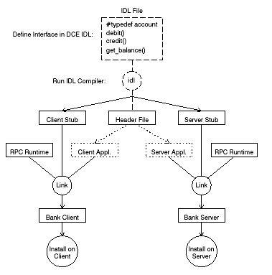
DCE RPC

Slide 14
DCE RPC (cont.
A flexible way of finding the server is through the DCE Directory service.
Server first needs to advertise itself in the directory service.
An endpoint mapper service is used to register the endpoint or port on which the service is running
RPC administration is minimal

Slide 15
DCE Technology Components:
DCE Directory Service
Distributed replicated database service
Directory Service Components
Cell Directory Service
[stores names and attributes
of resources in a DCE cell]
Global Directory Agent
[intermediary between cell’s
CDS and rest of the world]

Slide 16
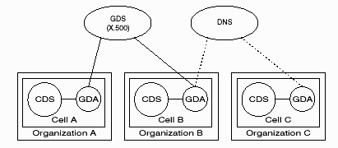
DCE Directory Service
GDS is a global directory service which can be implemented based on the X.500 standard or the DNS service.
The XDS ( X open directory service ) API is used to access the directory service components.

Slide 17
DCE Directory Service
CDS information consists of directory entries ( name and attributes), directories, and clearinghouses (physical database)
CDS achieves availability and speed through replication of directories and caching of entries.

Slide 18
DCE Technology Components:
DCE Time Service
DCE Distributed Time Service
Time clerk
Time servers ( local time server,
global time server, courier time server)

Slide 19
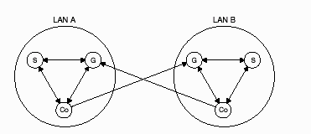
DCE Time Service
Courier time server synchronizes with a global time
server
The notion of correct time must come from an external time provider ( may be hardware device or the administrator)
DTS time format is UTC (an universal standard supported by NIST) – broadcast by a variety of sources

Slide 20
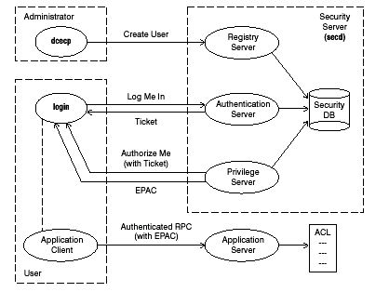
DCE Technology Components:
DCE Security Service
DCE Security Service

Slide 21
Simplified Kerberos Protocol
A
S : A,B
S
A : {K_{ab}, Ticket_{ab}}_{Kas}, where
Ticket_{ab} = {B,A, addr, Ts, L, K_{ab}} K_{bs}
A
B : Authenticator_{ab}, Ticket_{ab}, where
Authenticator_{ab} = {A, addr, Ta} K_{ab}
B
A : {T_{a} + 1}_{Kab}

Slide 22
DCE Distributed File System
DCE Distributed File System
DFS components : cache manager, file exporter , token manager and DCE local file system .
DFS gives an uniform file access , is a high performance file system, and makes its services and data highly available.It is also interoperable with other file systems .

Slide 23
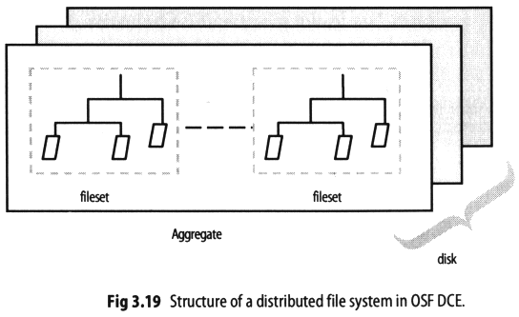

Slide 24
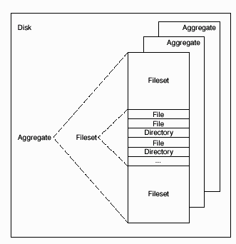
DCE Technology Components:
DCE DFS
DCE Distributed File System
DFS data organization

Slide 25
What is CORBA
CORBA( Common Object Request Broker Architecture ) is a distributed object oriented client server architecture
  includes an object oriented RPC mechanism
  Object services such as the naming and tradingservices
  language mappings for different programming languages
    a standard that enables an object written in one programming language, running on one platform to interact with objects across the network that are written in other programming languages and running on other platforms
    a client object written in C++ and running under Windows can communicate with an object on a remote machine written in Java running under UNIX.
  interoperability protocols

Slide 26
OMG
The CORBA specification was developed by the Object Management Group (OMG)
  An international, not-for-profit group consisting of approximately 800 companies and organizations defining standards for distributed object computing
  The OMG was established in 1988 and the initial CORBA specification came out in 1992. Significant revisions have taken place afterwards.
  Version 2.0, which defined a common protocol for specifying how implementations from different vendors can communicate, was released in the mid-nineties.
  The current version of CORBA is 3.0, which introduced the CORBA Component Model.
CORBA is only one of the specifications they develop. They are also behind other key object oriented standards such as UML (Unified Modeling Language)

Slide 27
Specification vs. Implementation
CORBA, as defined by the OMG, is a standard or specification and not a particular piece of software.
Several implementations of the CORBA standard – e.g. IBM’s SOM (a.k.a. SOMobjects) and DSOM architectures.
Used in enterprise apps
  One of the most important and most frequent uses is for servers that must handle a large number of clients, at high hit rates, with high reliability.
  Other users: The Weather Channel, GNOME, US Army and CNN

Slide 28
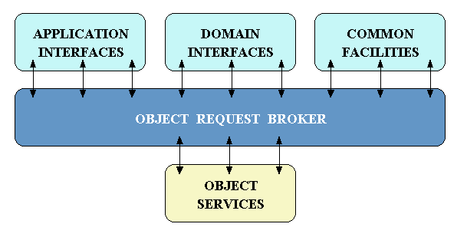
CORBA Concepts
Object management architecture (OMA)

Slide 29
CORBA Components
IDL
  Interface Definition Language
Client / Server CORBA Objects
  Abstract objects based upon a concrete implementation
ORBs
  Object Request Brokers
GIOP / IIOP
  General and Internet InterORB Protocols

Slide 30
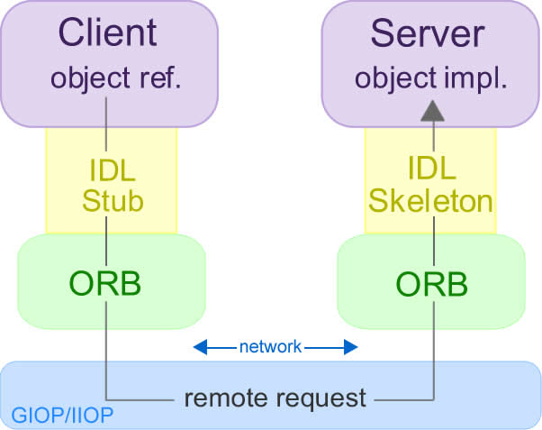
Interface Definition Language(IDL)
Defines public interface for any CORBA object.
Client and Server implemented based on compilation of the IDL
OMG has defined mappings for:
  C, C++, Java, COBOL, Smalltalk, ADA, Lisp, Python, and IDLscript
Notes:
The client thinks it is invoking the object instance on the server, but it is actually invoking the IDL stub
Stub uses inter-process communication mechanisms like TCP/IP sockets to transmit the request and receive a reply

Slide 31
IDL Features
Pass by reference and by value
In, out, and inout parameters
Inheritance, polymorphism, encapsulation
Throwing of exceptions
The Any Type (resolved at runtime)
Callbacks
  Enables Peer-to-Peer Object Communication.
Also supports:
  structs, unions, enumerations, all c++ scalars, arrays, sequences, octets, strings, constants, and typedefs.

Slide 32
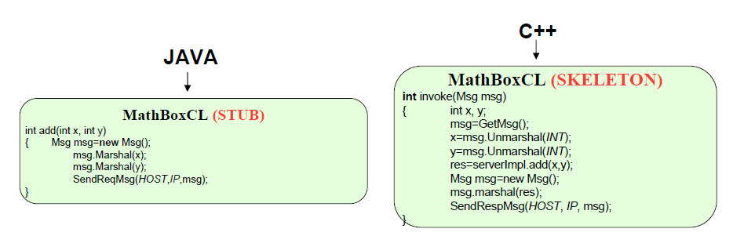
Distribution Transparency and
Inter-operability
Client
MathBox obj = new MathBoxCL();
Integer result = obj.add(10,20);
Server
int add(int x, int y)
{ return x+y;}

Slide 33
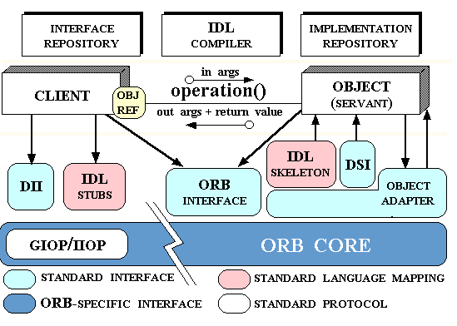
CORBA Concepts
CORBA ORB architecture

Slide 34
CORBA Concepts
How is ORB different from RPC ?
Within an RPC one calls a specific function , and the data is separate.
In contrast, in an ORB we are calling a method within a specific object. Thus different object classes may respond to the same method invocation differently.
Client IDL Stubs : static interface to object services.
DII (Dynamic invocation interface) :discover methods to be invoked at run time
Interface repository APIs : obtain and modify the description of the registered component interfaces.

Slide 35
CORBA Concepts
Server IDL stubs : static interfaces to the service exported by the server
Dynamic skeleton interface : run time binding mechanism for servers to handle incoming method calls.
Object Adapter : provides run time environment for instantiating server objects, passing requests to them, and assigning them object Ids.
Implementation repository : run time repository of information about classes a server provides.

Slide 36
Client / Server CORBA Objects
Abstract
  Do not have their own implementation. The elements of a CORBA object (interface, implementation, and location) are held rendered via other elements.
Implemented via a Servant
  A servant is a block of code (usually an instance of a class) which implements the public interface of the CORBA object. Depending on the server policies, there may or may not be multiple instances of the servant and it may or may not be multi-threaded.
Configured in code or at server startup
  Unlike COM+ and EJB the policies for a CORBA object which control things such as Security, threading, and persistence are not console configurable
Notes:
In CORBA, a Servant is the invocation target, containing methods for handling the remote method invocations. In the newer CORBA versions, the remote object on the server side is split into the Object (that is exposed to remote invocations) and Servant (to which the former part delegates the method calls). It can be one Servant per remote Object, or the same servant can support several (possibly all) objects, associated with the given Portable Object Adapter. The Servant for each Object can be set or found "once and forever" (servant activation) or dynamically chosen each time the method on that object is invoked (servant location). Both servant locator and servant activator can forward the calls to another server. In total, this system provides a very powerful means to balance the load, distributing requests between several machines.

Slide 37
Object Request Brokers (ORBs)
Responsible for all communication
  Locating objects
    Implementation specific
    Known IOR(Inter-Object Reference)
  Transferring invocations and return values
  Notifying other ORBs of hosted Objects
Must be able to communicate IDL invocations via IIOP
If an ORB is OMG compliant, then it is interoperable with all other OMG compliant ORBs

Slide 38
Inter ORB architecture
CORBA 2.0 added interoperability by adding a mandatory Internet Inter ORB protocol (IIOP)
Every ORB must either implement IIOP or provide a half bridge to it
GIOP vs. IIOP
General inter - ORB protocol ( GIOP) : specifies a set of message formats and common data representations for communications between ORBS. The CDR ( common data representation) maps data types defined in IDL into a flat networked representation
Internet Inter ORB protocol (IIOP) : specifies how GIOP messages are exchanged over a TCP/IP network. The IIOP makes it possible to use the internet as a backbone ORB which other ORBs can bridge
ORB A
ORB B
bridges
Backbone ORB(IIOP)
ORB C
ORB D

Slide 39
CORBA Object services
CORBA Services provide basic functionality - includes creating objects, controlling access to objects, keeping track of relocated objects and to consistently maintain relationship between objects.
The Naming Service : which allows clients to find objects based on names;
Persistence service : provides an interface to store components on storage servers.
Event Service : Allows components on bus to dynamically register or unregister interest in events.
Load Balancing
Fail-over support
Security

Slide 40
CORBA Domain Services
Domain Services : Built to order middleware
Component providers can provide their objects without any concern for system services. Depending on customer’s needs developer can mix original component with combination of CORBA services.
Example : one may develop a component called “car” and create a concurrent , persistent, transactional version of car through multiple inheritance.
Some ORB implementations lets one add methods on the fly to existing classes.

Slide 41
CORBA Horizontal Facilities
Collection of IDL defined frameworks that provide services of direct use to application objects.
Examples : mobile agents , data interchange, workflow , printing facilities, firewalls etc.

Slide 42
ORB vendors
Orbix (IONA) → Enterprise CORBA
Orbacus (IONA) → small footprint, embeddable CORBA
Visibroker (Borland) → for Java, C++, C#.
MICO (ObjectSecurity) → available as GNU open source software
ORBexpress (Objective Interface Systems) → a real-time ORB
ORBit (GNOME) →for C, C++ and Python
OmniORB → for C++ and Python
opalORB → for Perl
JacORB →for Java
OmniBroker → for non-commercial use. C++ and Java

Slide 43
CORBA Integrations and Deployments
Browsers – e.g. Netscape
The Enterprise Edition of IBM’s WebSphere integrates CORBA (as well as Enterprise Java Beans) to build highly transactional, high-volume e-business applications
AT&T
  Late 1990’s developed 20 to 40 systems using CORBA for both internal and external access
The Weather Channel (CORBA + Linux)
Raytheon (C++ and CORBA)
Boeing

Slide 44
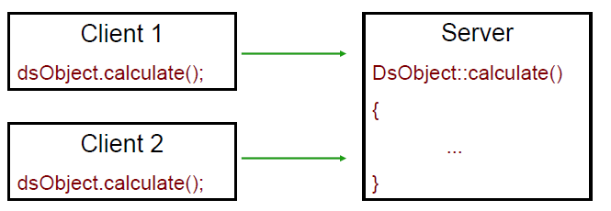
Object Adapters
More than one client calling same object ➔ demultiplex
Queue request and run in separate threads
Security between the objects
  Share methods, separate data
  Sandboxing
Object Lifespan
  Transient Objects
  Persistent Objects

Slide 45
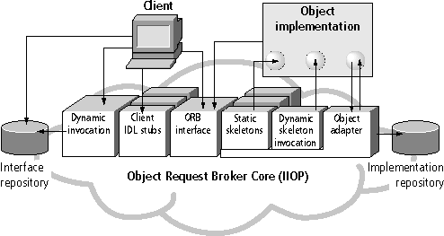
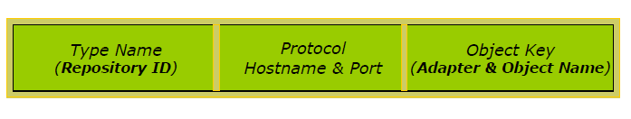
CORBA Architecture

Slide 46
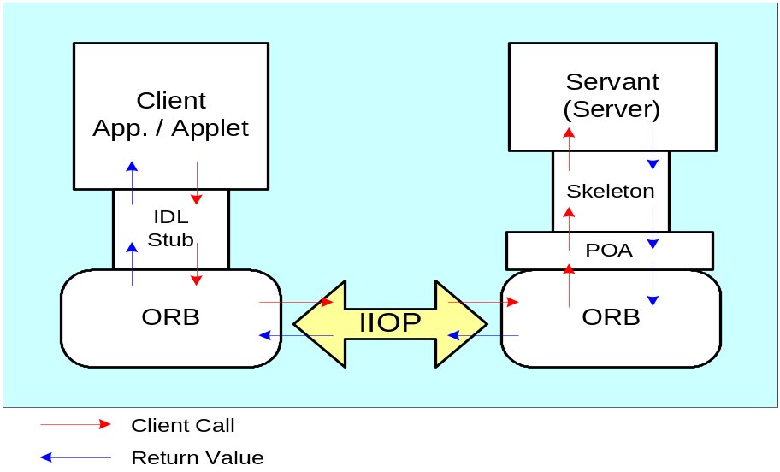
Portable Object Adapter (POA)
Mechanism to connect a request with to the code to process it
Is a standard component defined by the CORBA specification
Goal → build objects that can be supported in different ORBs
Assists an ORB in delivering client requests to server object implementations (servants)
Generates and interprets object references
Portability achieved by standardizing
skeletons classes that are generated
by the IDL compiler
Deactivates idle objects' servants;
activates them when needed

Slide 47
CORBA Architecture

Slide 48
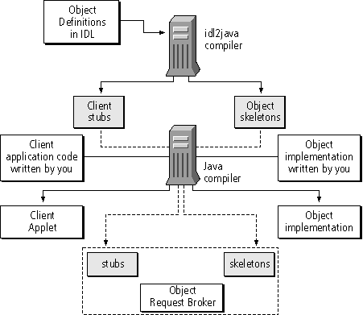
Steps to Write a CORBA Object in Java

Slide 49
CORBA Advantages and Drawbacks
Advantages
  Rapid development of API’s
  Inter-language and operating system operability
  IIOP faster than HTTP
  Simplifies development of distributed applications
Drawbacks
  Lower Level than COM+/.NET/EJB
  Configuration in Code
  Steeper Learning Curve than other solutions
  Firewalls
  Location transparency
  objects residing in the same address space and accessible with a simple function call are treated the same as objects residing elsewhere

Slide 50
CORBA vs. DCOM vs. Java RMI
DCOM
  DCOM supports an object-oriented model, but differs substantially from classical OO models. DCOM object provides services through one or more distinct interfaces.
  DCOM lacks polymorphism
  CORBA can be deployed far more widely than DCOM and runs in most current OS environment, while DCOM is running almost exclusively in the Windows environment.
Java/RMI
  JAVA/RMI systems fall short of seamless integration because of their interoperability requirements with other languages.
  JAVA/RMI system assumes the homogeneous environment of the JVM, which can only take advantage of Java Object Model.
Notes:
First,DCOM supports objects with multiple interfaces and provides a standard QueryInterface() method to navigate among the interfaces. This also introduces the notion of an object proxy/stub dynamically loading multiple interface proxies/stubs in the remoting layer. Such concepts do not exist in CORBA.
Second, every CORBA interface inherits from CORBA::Object, the constructor of which implicitly performs such common tasks as object registration, object reference generation, skeleton instantiation, etc. In DCOM, such tasks are either explicitly performed by the server programs or handled dynamically by DCOM run-time system.

Slide 51
Hello World Example (Client)
define constant $hello-world-ior-file = "c:\\temp\\hello.ior";
define method main () => ()
let orb = corba/orb-init(make(corba/<arg-list>), "Functional Developer ORB");
let world = as(<world>, corba/orb/file-to-object(orb, $hello-world-ior-file));
format-out("%s\n", world/hello(world));
end method main;
begin
main();
end;
interface world
{
string hello();
}

Slide 52
Hello World (Server)
define constant $hello-world-ior-file = "c:\\temp\\hello.ior";
define class <world-implementation> (<world-servant>)
end class;
define method world/hello (world :: <world-implementation>)
  => (hello :: <string>)
  "Hello World!"
  end method;
define method main () => ()
let orb = corba/orb-init(make(corba/<arg-list>), "Functional Developer ORB");
let poa = corba/orb/resolve-initial-references(orb, "RootPOA");
let impl = make(<world-implementation>);
let world = portableserver/poa/servant-to-reference(poa, impl);
corba/orb/object-to-file(orb, $hello-world-ior-file, world);
let manager = portableserver/poa/the-poamanager(poa);
portableserver/poamanager/activate(manager);
corba/orb/run(orb);
end method main;
begin
main();
end;

